Slide 1

Configuring Eclipse for ENOVIA
2014x

Slide 2
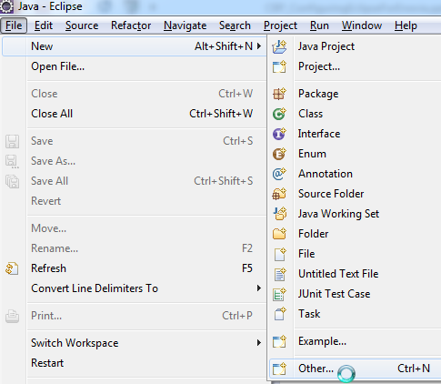
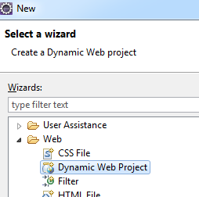
Create a Dynamic Web Project
File > New > Other The New dialog box appears
Select Web > Dynamic Web Project

Slide 3
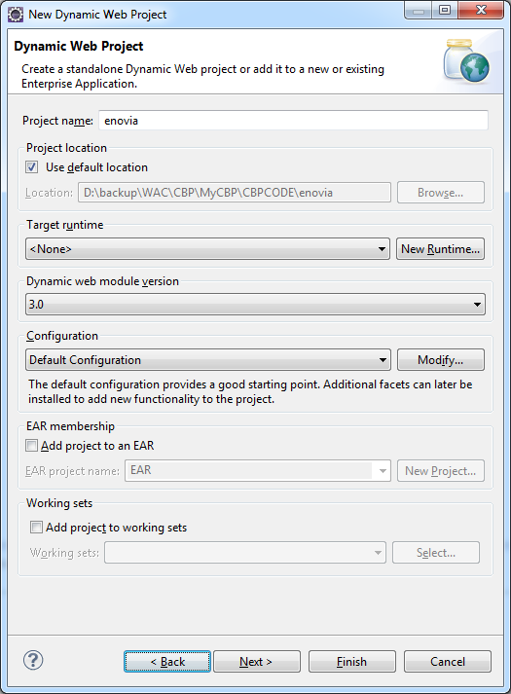
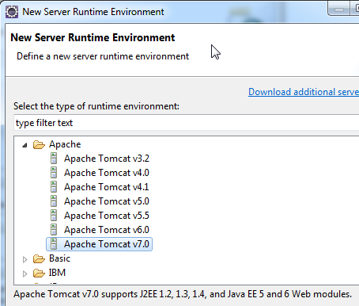
Create a Dynamic Web Project
Click on New Runtime The New Server Runtime Environment window opens
Select Apache Tomcat v7.0
Click Next

Slide 4
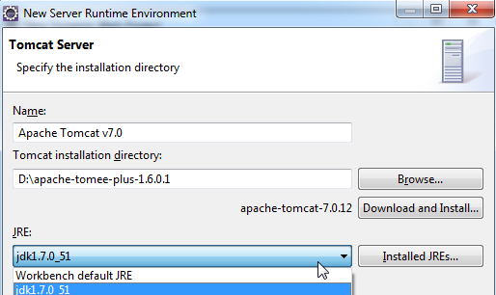
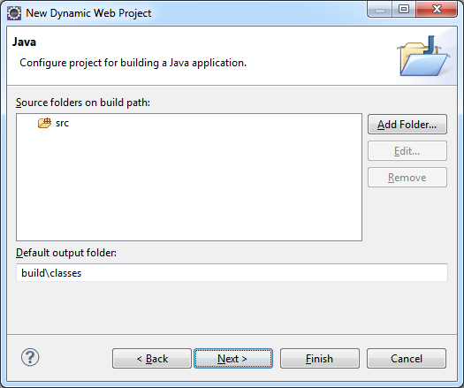
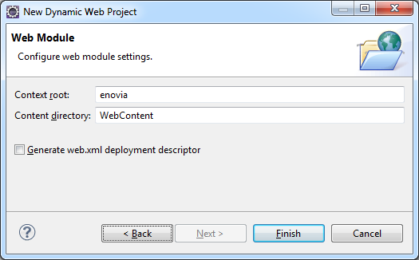
Create a Dynamic Web Project
In the next dialog box, you select JRE as Workbench default JRE & also the Tomee installation directory
Click Finish You return to the New Dynamic Web Project window
The next step is to add source folder on build path. We let it remain as default
Click on Finish

Slide 5
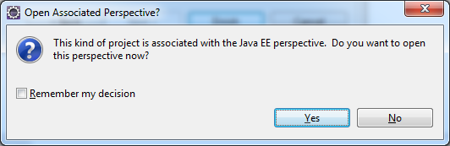
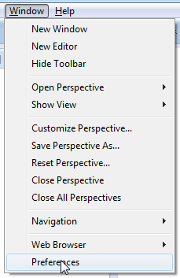
Set Windows Preferences > Disable all Validations
We choose to open the Java EE perspective Click on Yes
Select Window > Preferences

Slide 6
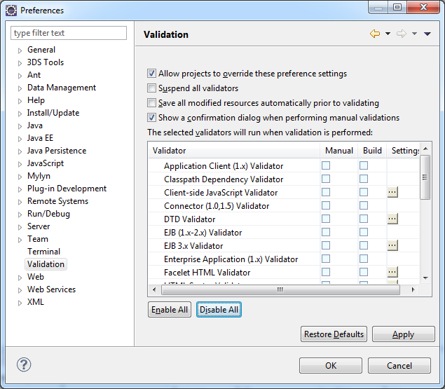
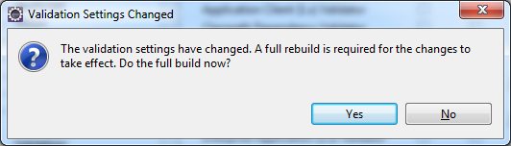
Set Windows Preferences > Disable all Validations
In the Validation node, Disable All validations
Click on Apply The Validation Settings Changed window is displayed
It prompts that a full rebuild is required for changes to take effect. Click Yes

Slide 7
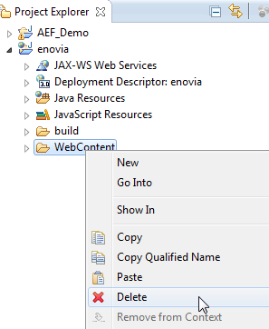
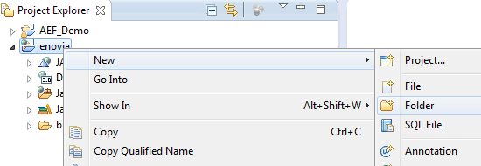
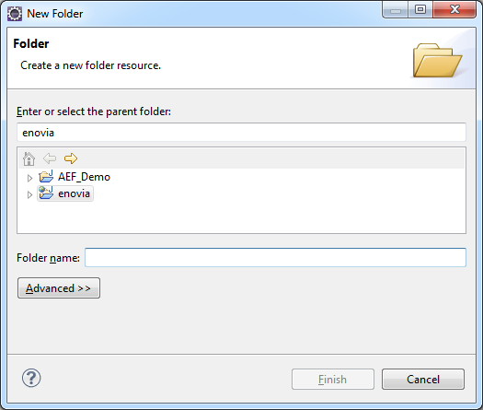
Web Content Folder linked to the enovia folder deployed in Tomee
We delete the WebContent folder
In the contextual menu of the enovia node, select New > Folder The New Folder window appears
Click on Advanced >>

Slide 8
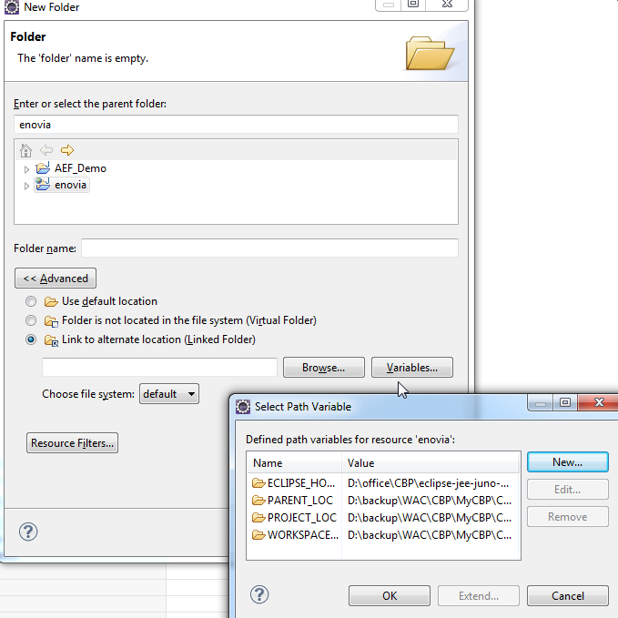
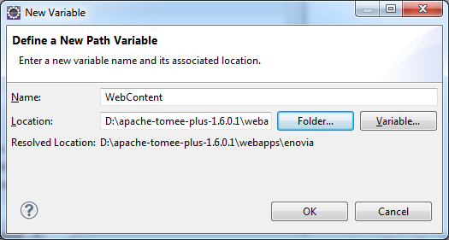
Web Content Folder linked to the enovia folder deployed in Tomee
The New Folder window is displayed
Select the radio button “Link to alternate location (Linked Folder)”
Click Variables The Select Path Variable dialog box is displayed
Click on New Define a new variable “WebContent”
The Location for it is browsed to the enovia deployment folder inside tomee

Slide 9
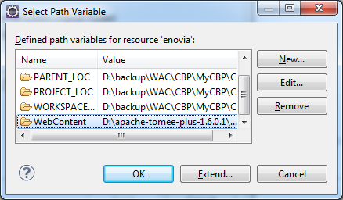
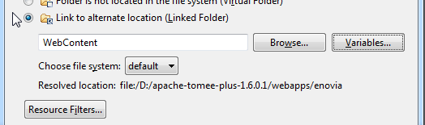
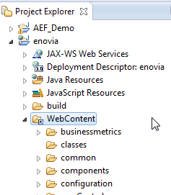
Web Content Folder linked to the enovia folder deployed in Tomee
The WebContent variable is now set and listed in the Select Path Variable dialog box
The link to alternate source location is now updated in the New Folder dialog box
Click on Finish The WebContent node is now displayed under the enovia node in the Project Explorer tree

Slide 10

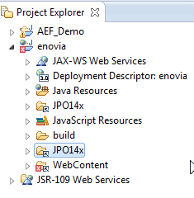

Extract JPOs from Database to a Folder in your Local Drive
Open the MQL prompt
Run the command: extract program * source “C:\temp\JPO14x” demangle;
Create a new folder under enovia project which points to the above folder where all our JPO source was extracted
On similar lines as the WebContent folder, we create a new Variable JPO_Source and link it to the newly created folder above
You will notice that folders JPO_14x is now seen under enovia Please note the variable name for this folder is JPO_Source
Since Validation was turned off, for all options you will notice at the bottom right the Building Workspace process takes relatively far lesser time

Slide 11
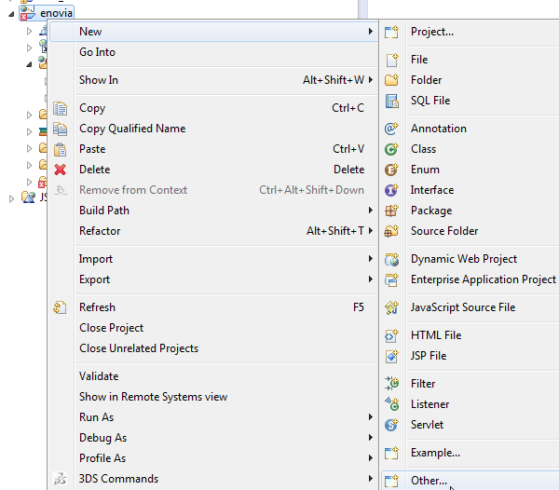
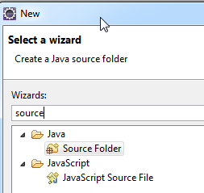
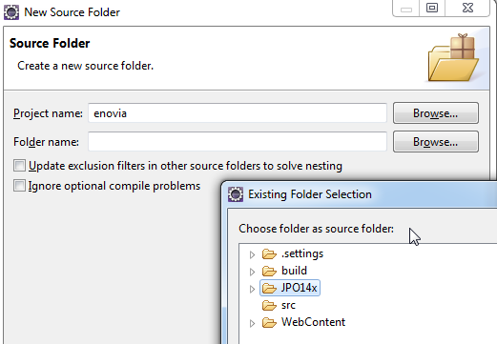
Extracted JPO Folder is now added as Java Source folder under eclipse Project
We need to make this new folder JPO14x under the enovia project, as the Java source folder of our project
Choose in the contextual menu of enovia project, New > Other
Input “source” in the Wizards field, and choose Java > Source Folder
Select JPO14x as the source folder

Slide 12
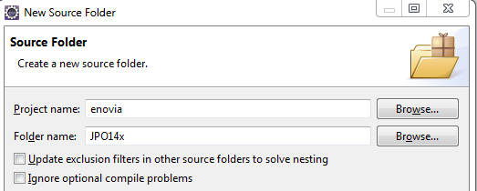
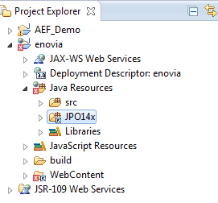
Extracted JPO Folder is now added as Java Source folder under the Eclipse Project
You will notice that the JPO14x folder now is listed under enovia project > Java Resource

Slide 13
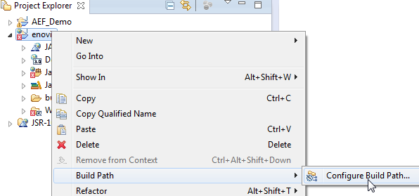
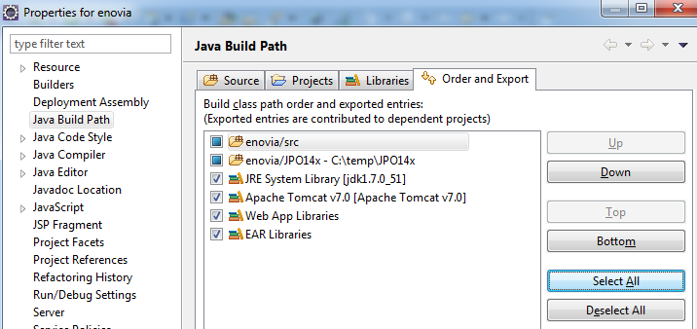
Next step is to configure the Build Path
Selec the Order and Export tab Click Select All & click OK

Slide 14
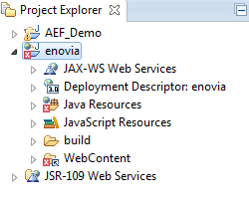
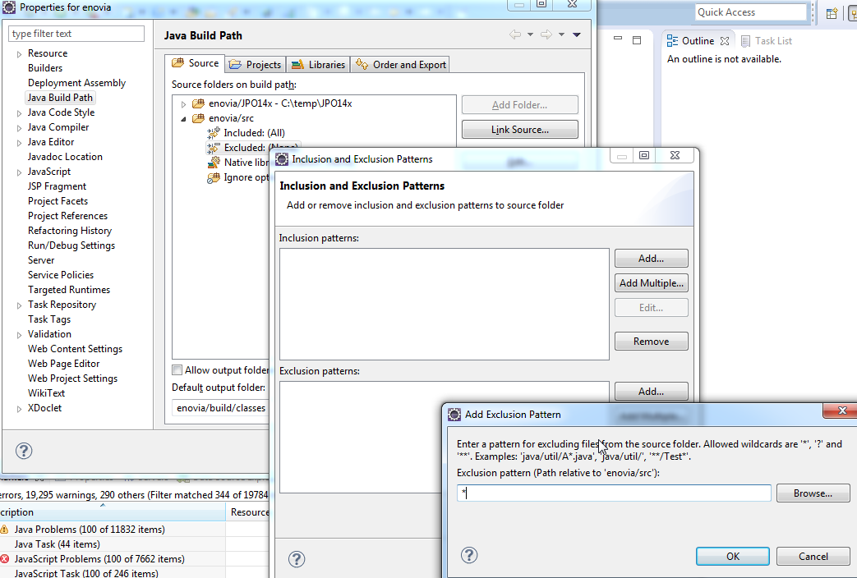
Configure Build Path > Exclude Sources from Build
The Project Explorer tree has nodes with red tag Implies that quite a few sources will have to be excluded from the build operation
Build Path > Configure Build Path
Source tab > Excluded > Edit > Exclusion pattern = *

Slide 15
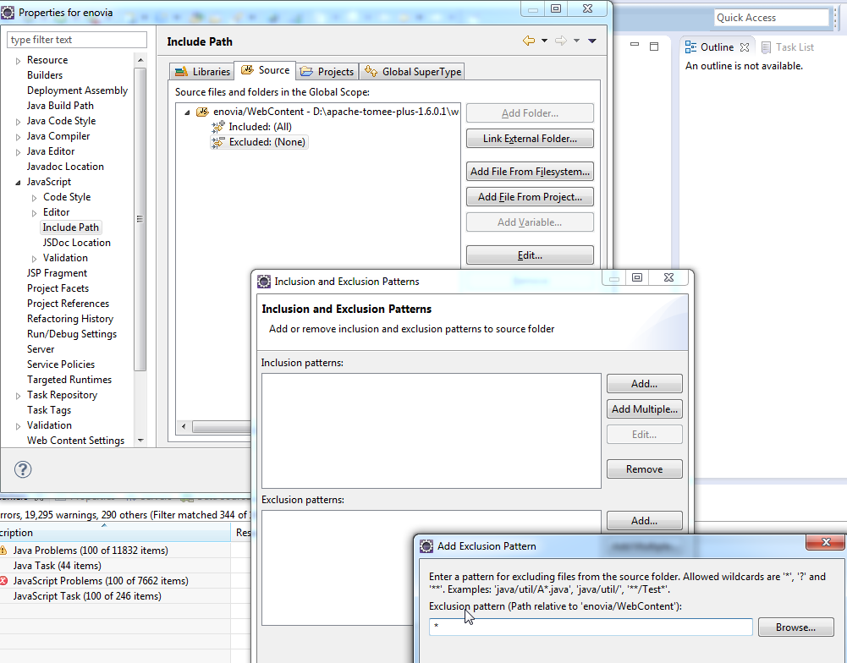
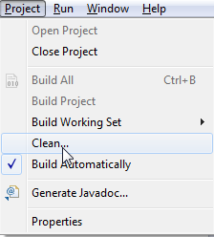
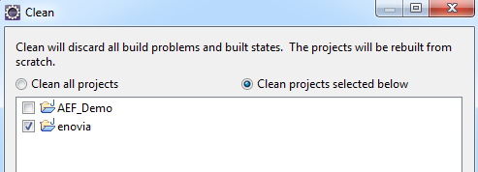
Configure Build Path > Exclude JavaScripts from Build
On similar lines, set the exclusion pattern for Javascript files
Do a Project > Clean
Choose Clean projects selected below

Slide 16
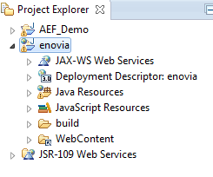
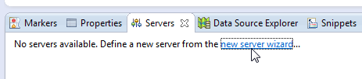
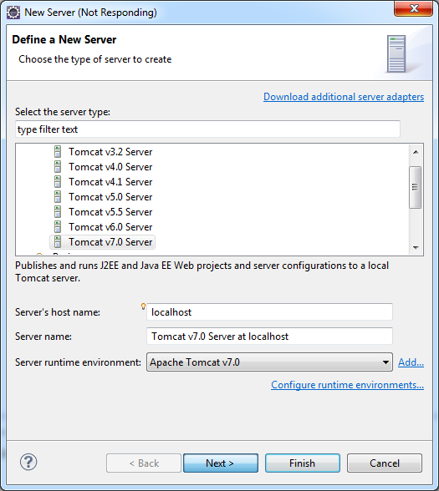
Configure the Tomee App Server within Eclipse
You will notice the red tags in the tree nodes all disappear
In the Servers tab, select new server wizard…
The New Server dialog box is displayed
Let the default seletion remain and click on Next

Slide 17
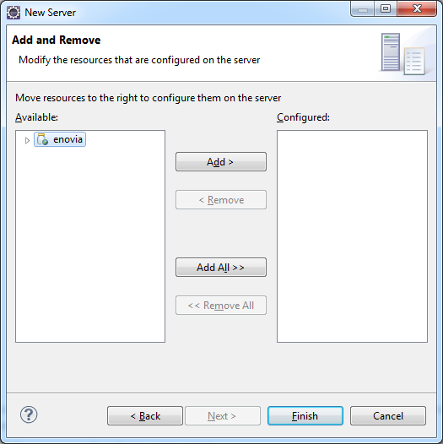

Configure the Tomee App Server within Eclipse
Move enovia to configure it on server Select Finish

Slide 18
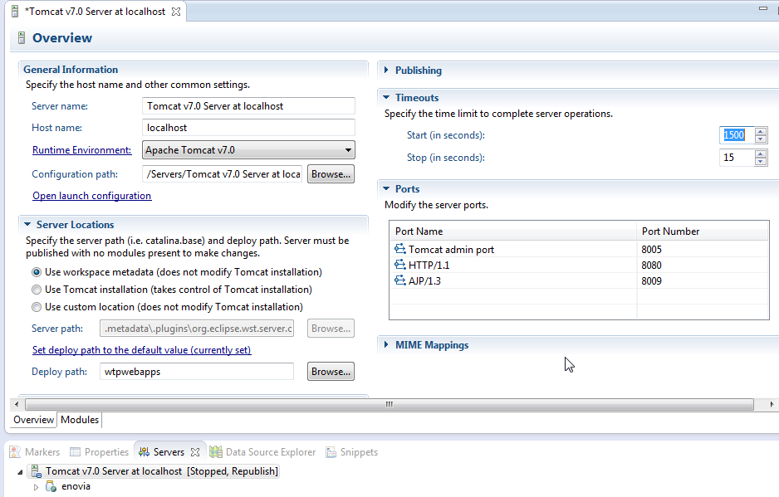
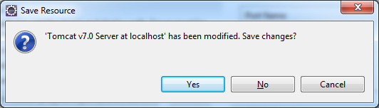
Configure the Tomee App Server within Eclipse
Timeout = 1500
Save the changes done

Slide 19
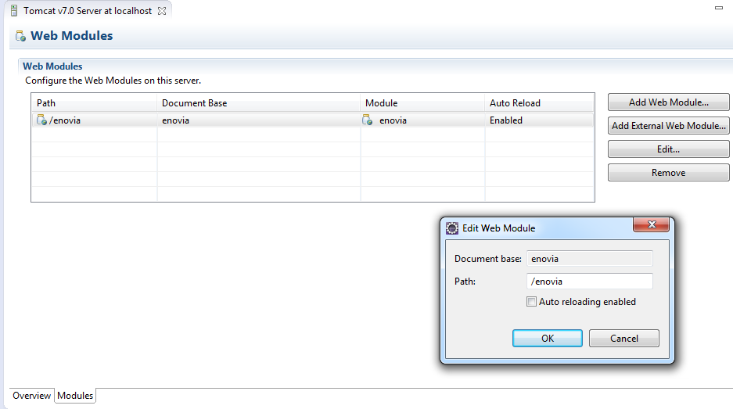
Configure the Tomee App Server within Eclipse
Select the Modules tab
Select the first row that of enovia
Click on Edit The Edit Web Module dialog box is displayed
Uncheck the “Auto reloading enabled” checkbox

Slide 20
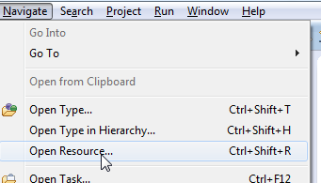
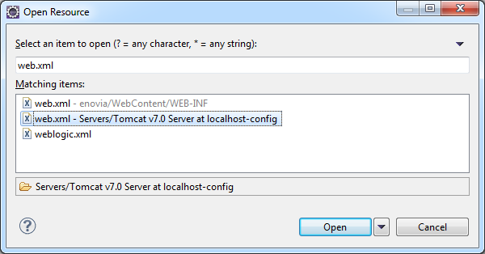
Configure the Tomee App Server within Eclipse
Navigate > Open Resource
Select web.xml – Servers/Tomcat v7.0 Server at localhost-config

Slide 21
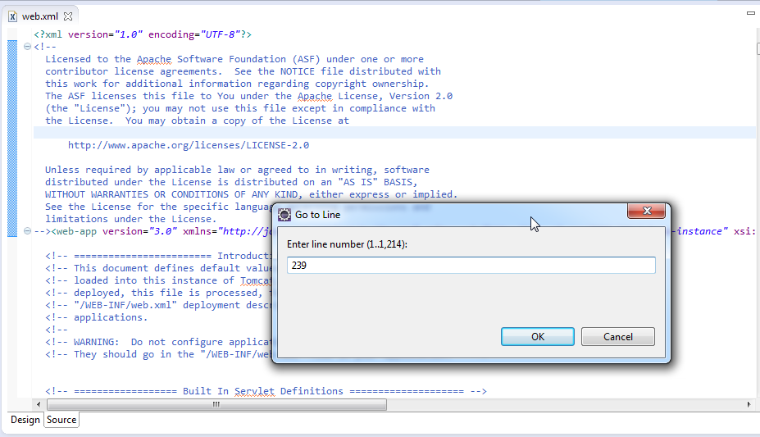
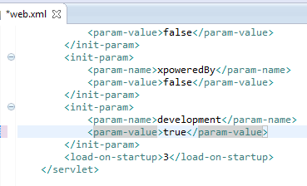
Configure the Tomee App Server within Eclipse
Go to line 239
Change the development parameter value to true

Slide 22
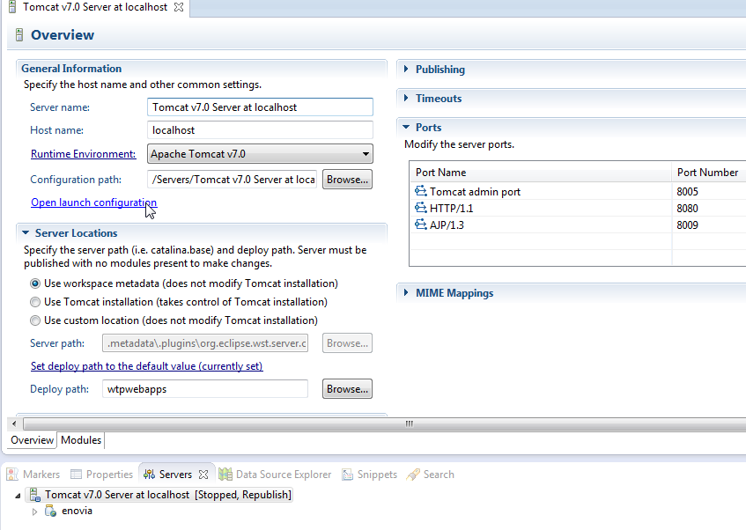
Configure the Tomee App Server within Eclipse
Open launch configuration of the tomcat server

Slide 23
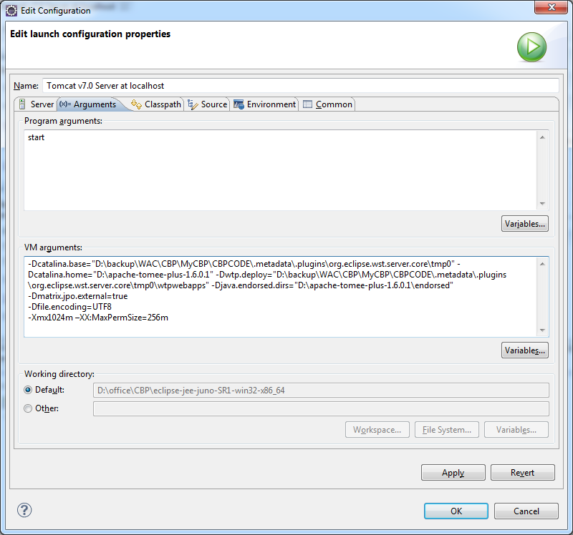
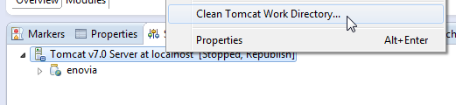
Configure the Tomee App Server within Eclipse
In the Argument tab, VM arguments field input: Ensure these values are not copy-pasted but explicitly fed in
-Dmatrix.jpo.external=true
-Dfile.encoding=UTF8
-Xmx1024m –XX:MaxPermSize=256m
Click on Apply & then OK
Clean Tomact Work Directory

Slide 24
Launch Tomee in Debug mode
Start the server in debug mode

Slide 25
The END

